Slide 1
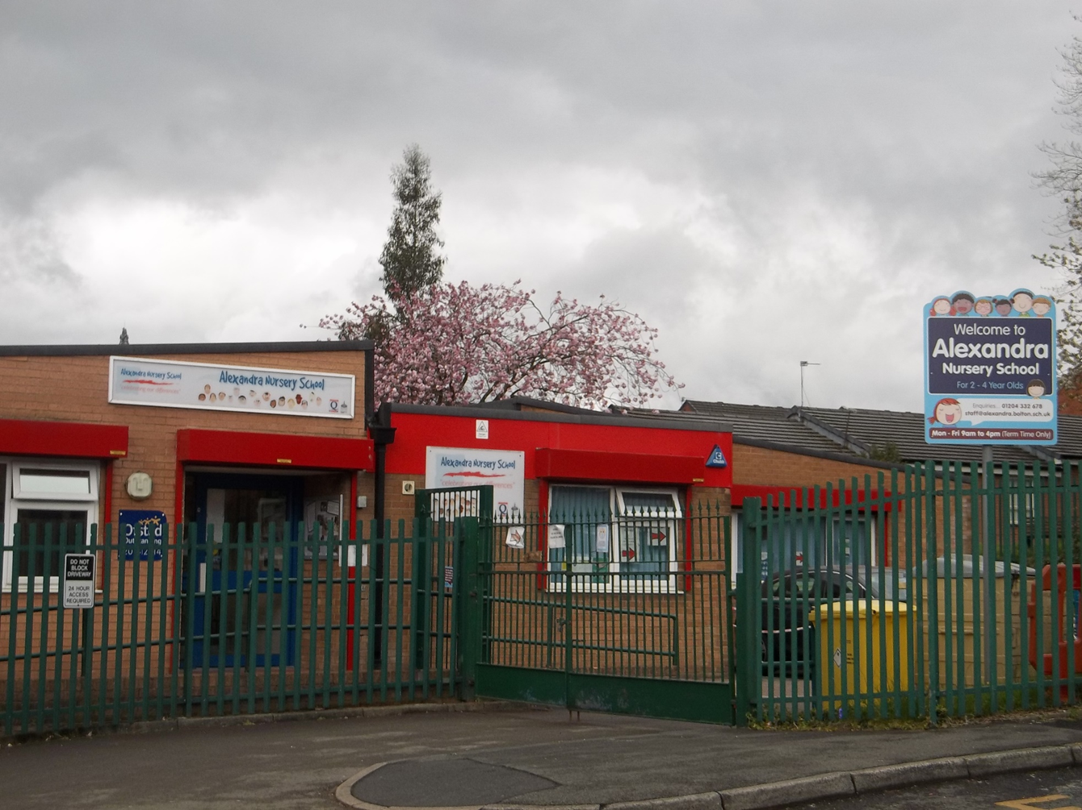
‘A rich community of learners, striving for excellence and celebrating success’. Reading Project.
Alexandra Nursery School is a Local Authority Maintained Nursery School, situated in the Daub Hill Area of Bolton.
The school provides term time education, 9am to 4pm, 5 days per week to; 104 part time 3 and 4 year olds, 40, 2 year olds and 8 children in the High Needs Base.
The majority of the children are in are in receipt of 2 year old funding or the universal 15 hours.
The annual co-hort is very vulnerable and many children fall in to 2 or 3 vulnerable groups. (EAL/CL/SEN/WBB).
41% of the current cohort (51 children) speak English as an Additional Language. (This increases term by term).
Children enter nursery below and well below attainment levels expected for their age in Communication and Language, PSE and Reading.
There are 11 different languages spoken in the school.
There are 51 children currently attending the nursery from a very diverse range of backgrounds and cultures.
The cohort is transient and tends to change each year. For example, over the past 2 years, there has been an increase in the number of African families attending of which there were 13 refugee families.

Slide 2
Reasons for becoming involved with the project.
A large emphasis is already placed on the importance of reading at the school. Following inspection in 2019 and their deep dive in to reading, we were graded outstanding. However I wanted to further enhance parental engagement within this area.
To support disadvantaged children with more access to reading materials.
The project was an opportunity to support and further the professional development of practitioners.
The project was an opportunity to share good practice and gain further support from primary schools because we are such a small setting and specialising in nursery age children.

Slide 3
Barriers to learning.
Reading at Home.
Following a training day presented by Alex Quigley, I was astounded that 1 in 8 households have no books!!!!!
This information made me reflect on the children at Alexandra nursery school and the resources they had at home.
- Maybe it was one of the reasons that children at Alexandra displayed negative reading behaviours and appreciation of books.
- If parents had limited means to buy books or were not modelling reading behaviours in the home, then children would only see this at Nursery.
Home reading books are returned in all states without reason and we would normally just charge for these but not receive any money or explanation as to why the book was damaged.
The Pandemic.
Another barrier was the pandemic.
English as an Additional Language.
Many of the parents and children at the school have English as an additional language.
Money
Resources cost a lot of money. How are we going to pay for this?

Slide 4
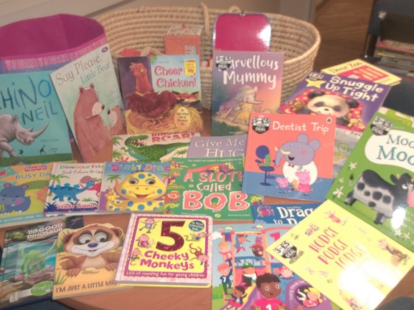
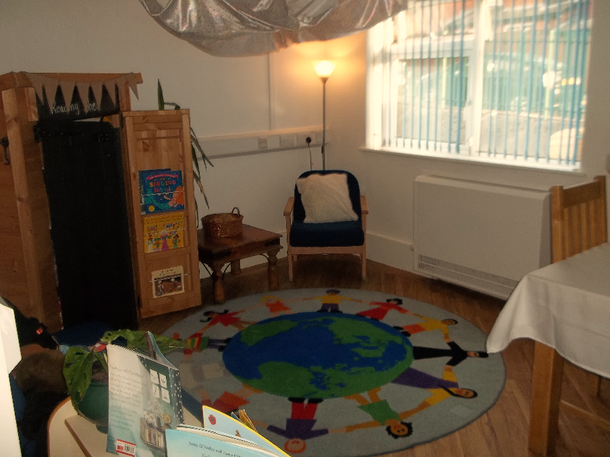
Overcoming Barriers.
We started to collect free books and cheap books from Facebook market/family/friends.
Made an application to the Shine Project for charity funding.
We used the pandemic as an opportunity to share our core stories for the differentiated key groups on Classdojo and Facebook. Key workers modelled the reading process and children could hear the core stories each day at home.
Staff reorganised all current books and we created a library as a special place to take children and invite parents, to teach reading behaviours and to foster a love of books. Staff will provide reading sessions for parents in Urdu and Gujurati.

Slide 5
Next Steps
Now the library is set up, Key workers will take their children in and will invite parents in, to model reading and empower parents to read with their child at home.
Staff are currently undertaking Mantra Lingua training, to work with EAL families. They will model the use of the pens with the aim of them reading with their children at home in their home language.
Finally, some schools in the project have discussed the possibility of supporting parents with reading at home, by using older siblings of the nursery children, to share their reading book at home.

Slide 6
Top Tips for Parental Engagement
We also aim to engage parents through non threatening activities that they will feel confident taking part in, like baking and forest school.
We try to avoid titles like ‘workshop’
These opportunities allow practitioners to talk generally about the use of books - fiction and non fiction.
They are able to talk about reading and model the reading process in a non threatening manner that educates parents and children.

Slide 7
Actions as a result of the Project.
To promote the Teaching guide as an effective resource for teaching reading, Communication and Language.
Hopefully, this will allow us to also generate income for the school.
See next few slides.

Slide 8
How we teach Communication and language, Reading and support EAL.
We use a variety of approaches that are combined in to sequenced and developmentally appropriate Together Time groups, to support language development.
ELKLAN
Sign-a-long
Brain Gym
Letters and Sounds
Language Through Listening and Nursery Narrative
The Language Journey
Language Through Listening
Nursery Narrative
Characteristics of Effective Learning and PSE
Each Together Time group has a set of related core stories that support the EYFS curriculum.
These stories focus on words in the here and now. For example, animals, body parts etc.
We have duplicate copies of the core stories so that they can be left out in the setting and used for home reading books.
-We also use core rhymes and songs at each stage to develop language fluency.

Slide 9
LETTERS & SOUNDS
- Voice Sounds – Exploring puppet sounds.
-Making own instruments.
ELKLAN - Understanding.
- Rigid/single channelled attention.
-1 information carrying word level.
-Blank level 1 – instructions
-Assess without visual cues. For example, can select cow from group of 3 animals.
LANGUAGE THROUGH LISTENING
– Language Through Listening
activities; games to develop eye contact, turn taking, building up listening and attention.
-’Good morning what’s your name?’
CORE BOOKS/ RHYMES
-Maisy books and Dear Zoo. Familiar characters.
-Repetitive language – Use of repeated key vocabulary and phrases. ‘I sent him back’, ‘oh dear!’,’ Where’s Maisy’, ‘No not Maisy’, ‘Maisy goes upstairs/downstairs’
-Rhymes/Action songs – ‘Twinkle Twinkle’ and ‘Baa Baa Black Sheep, wheels on the bus, ‘If you’re happy..’ ‘Wind the Bobbin Up’,’Roly Poly’, ‘Shaky shaky’, ’Grand old Duke’, ‘Hickory Dickory’, ‘I’m a Little Teapot’, ‘Old Macdonald’, ‘Miss Polly’, ‘Incy Wincey’,’ One Potato’
Maths –C ounting songs – Counting forwards in a range of ways.
For example, ‘1,2,3,4,5, once I caught a Fish Alive’.
Use of prepositions – up/down.
EYFS - Reading -
Is interested in and anticipates books and rhymes and may have favourites
• Has some favourite stories, rhymes, songs, poems
or jingles
• Repeats and uses words or phrases from familiar stories
• Fills in the missing word or phrase in a known rhyme, story or game, e.g. ‘Humpty Dumpty sat on a …’ • Enjoys rhythmic and musical activity with
percussion instruments, actions, rhymes and songs, clapping along with the beat and joining in with words of familiar songs and nursery rhymes
EYFS
Listening and Attention -Can join in with 10 minute Together Time’.
Speaking
•Holds a conversation, jumping from topic to topic.
•Learns new words very rapidly and is able to use them in communicating.
Puts 2 words together.
•Uses gestures, sometimes with limited talk, e.g. reaches toward toy, saying ‘I have it’. •Uses a variety of questions (e.g. what, where, who). •Uses simple sentences (e.g.’ Mummy gonna work.’)
•Beginning to use word endings (e.g. going, cats)
Vocab – animals, parts of the body, food and household items, cup, spoon, brush,
MAISY GROUP
(16-26months/22-36 months)
Core Books – Dear Zoo, Oh Dear! Farm Chase, Where’s Maisy? Maisy’s Bath time.
Magic Bag – household, food, farm, wild animals. Verb picture cards.
For all Toghether Times – see Teaching activities document.
LANGUAGE JOURNEY
Pages 5, 13-15. -Innovative Communicator.
Focuses on things that interest them, can understand more than they say (200 words) and are using two word phrases. I can use 50 single words.
Playing more with toys but get frustrated if not understood or don’t get their own way.
Innovative communicator – When you sing rhymes, I can join in with actions and sounds.
together.
STAGES OF BILINGUALISM – Telegraphic Speech. Repeats the adult. For example, ‘all gone’.
English Code – A) New to English B) Early Acquisition
SIGN-A-LONG
Basic needs, animals and commands.
Introduction of verbs.
Physical Development –
Brain gym - clapping hands to 5, opposite hands to shoulders then knees when counting.
-I am improving my fine motor skills and co-ordination.Thsi helps with walking,talking and drawing.
MATHS SONGS
MATHS CORE VOCABULARY

Slide 10
Maisy Group – core stories

