Slide 1
The Highwayman

Slide 2
Using just the name – what are your predictions
The Highwayman
Alfred Noyes (1904)

Slide 3
The Highwayman
Alfred Noyes (1904)

Slide 4
As you know the open was written in 1904. What reading barriers might you face?

Slide 5
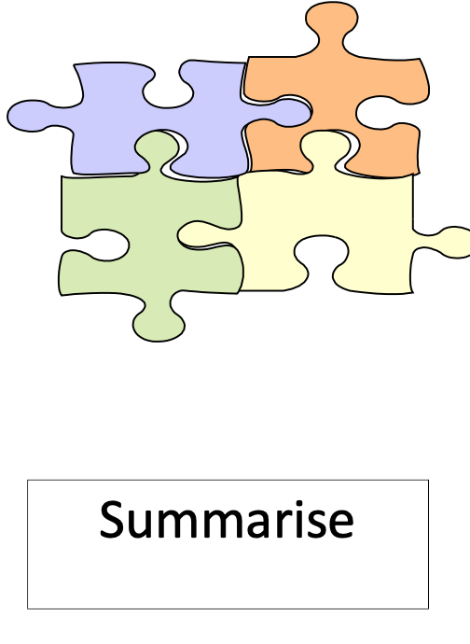
Without knowledge unfamiliar words, these skills will become challenging.

Slide 6
Two types of language
Written language
not usually used in everyday speech
Subject specific language
torrrent
claret
hollows
curse
brandished
cascade
tawny
gusty
breeches
rapier
stable wicket
casement
musket
muzzle
galleon
shutters
stirrups

Slide 7
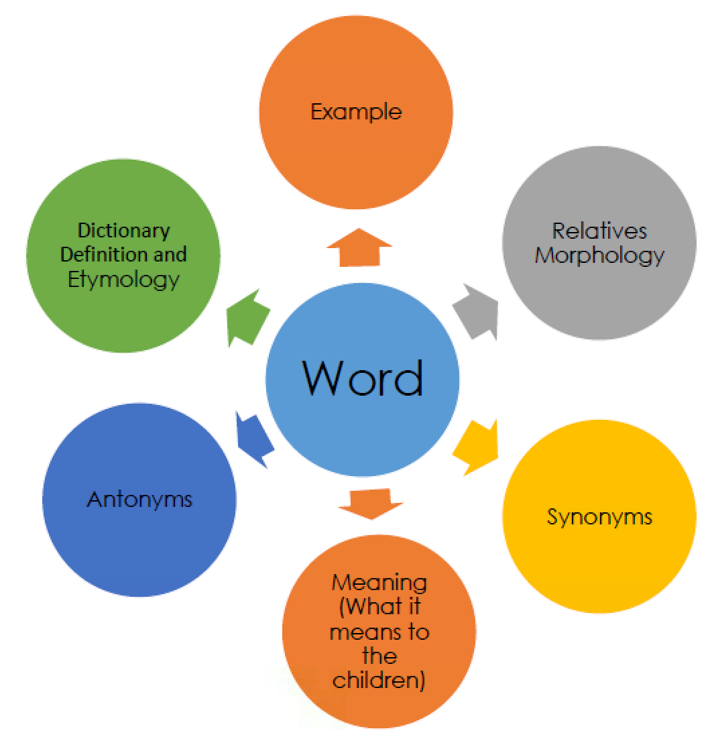
After the soldier thrust his rapier into his foe’s belly, he saw blood spurt out of the wound.
Rapier: a thin, light (double edged)sharp-pointed sword
Etymolgy: French rapière, from espee rapiere "long, pointed two-edged sword" (late 15c.),
modified with:
more rapier
most rapier
The word can be used to describe something sharp.
It can also be used to describe sharp wit.

Slide 8
rapier

Slide 9
Consider: In what ways will today’s lesson support you with the
rest of your learning around this text?

