Slide 1
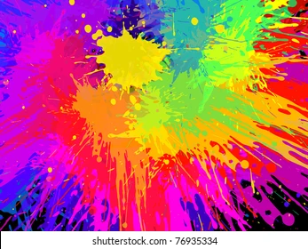
Colour

Slide 2
Vocabulary
dreary
crucial
camouflage
synthetic
inspired
ingenious
obtained
pigments

Slide 3
Vocabulary
Meaning: lacking in brightness or interest
Etymology: Old French = cloth
drabber
drabbest
drab
bright
cheerful
interesting
dull
borning
bland
uninspiring

Slide 4
Vocabulary

Slide 7
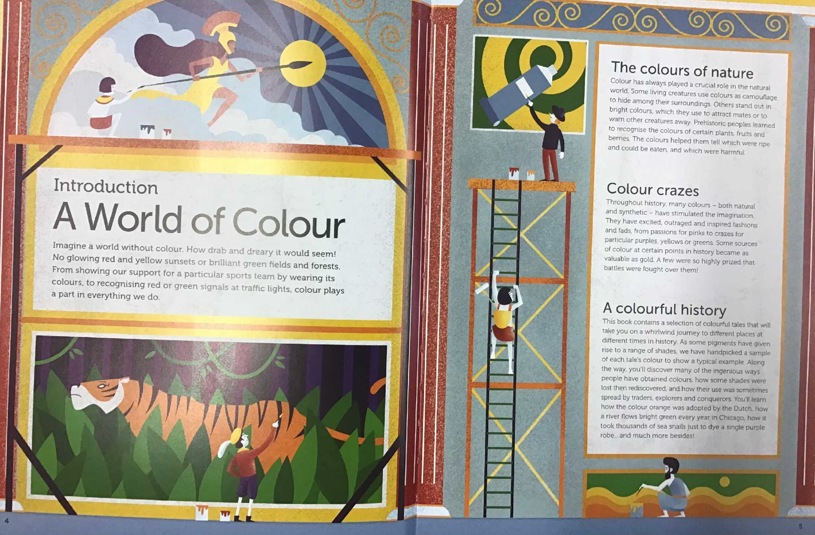

Slide 8
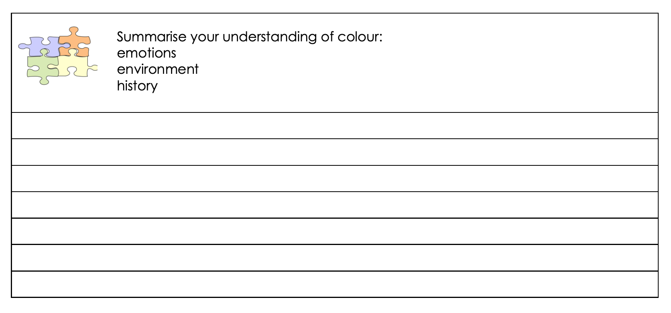

Slide 9
Task 1
1 and 2 work together to investigate the history of a colour: yellow, purple, blue, red, green
3 work with NW to investigate colour in nature
4 investigate: yellow, purple, blue, red, green

Slide 10
Task 2
Number 1: read the text and write a summary that explains what you have learnt
Number 2/3: will work with NW/ JA or AJ/ NS to write a summary
Number 4: Primary colours investigation

Slide 11
