Slide 1

Fluency
June 2021
Comprehension
Fluency
Decoding
By Jess Holland

Slide 2
Why is fluency important?
Reading aloud accurately and at a reasonable pace are important aspects of the reading process. If a child can do this then ‘cognitive space’ is freed up to allow them to concentrate on taking meaning from the text.
Notes:
That does not mean that we are neglecting any of the other strategies we are currently using. But like any skill, Fluency needs to be scaffolded and modelled explicitly in order for children to get better at this.

Slide 3
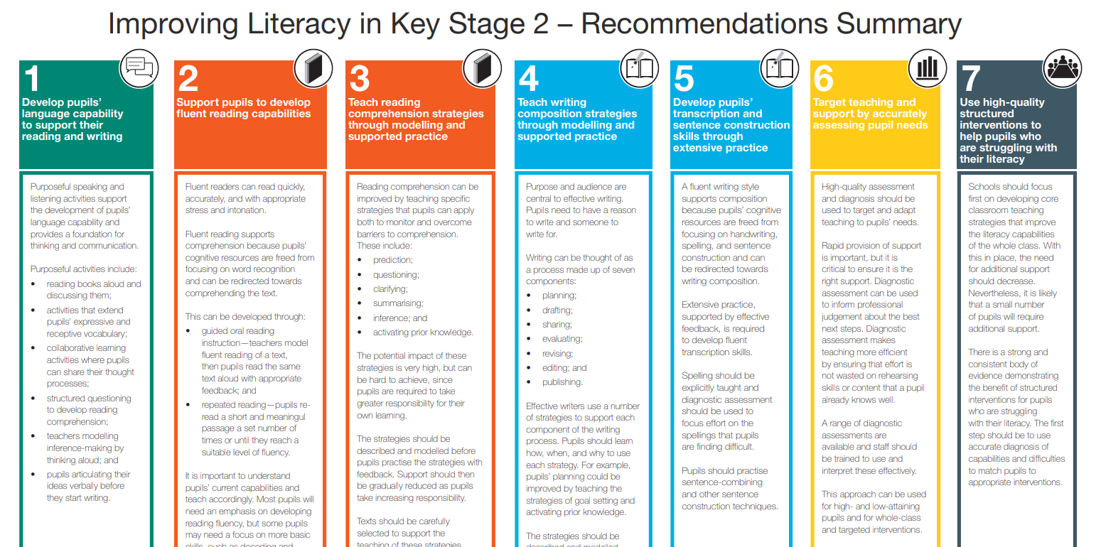
Notes:
This has been taken directly from the new guidance from the EEF. We will be using their recommendations to support the teaching of Fluency. As you can see Fluency, is just one of the key recommendations which contributes towards improving a child’s reading ability.

Slide 4
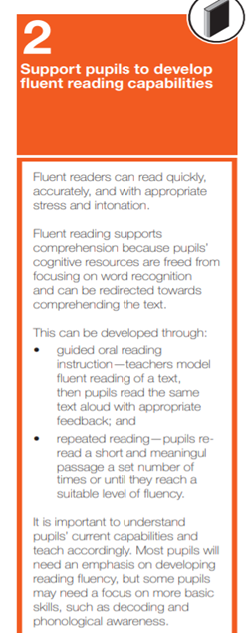
Where does Fluency sit in current legislation?
Support pupils to develop fluent reading capabilities – Key recommendation 2 in the EEF’s
Improving Literacy In Key Stage 2 Guidance Report
Fluent readers can read quickly, accurately, and with appropriate stress and intonation.
Fluent reading supports comprehension because pupils’ cognitive resources are freed from focusing on word recognition and can be redirected towards comprehending the text

Slide 5
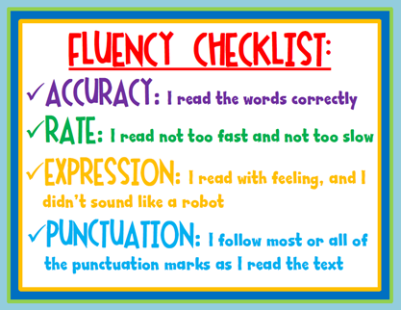
Non fluent readers
Listen to Child A.
With the Fluency checklist in mind, how would you help this child?
https://app.seesaw.me/pages/shared_item?item_id=item.c4ea4353-d789-420e-a24c-ddd27eae37fe&share_token=SkuqmdA8Swq9EYA_NBXqwA&mode=share
Notes:
We’re going to listen to a Year 2 Pupil reading a Turquoise Band book. Listen out/ make notes on his weaknesses as a non- fluent reader. What does he need more of?

Slide 6
Characteristics of non fluent readers
Children who read accurately but so slowly and haltingly that it impedes their understanding are likely to benefit considerably from this fluency into understanding approach.
Child A could read many Y2 spellings eg. pirate, captain, every, talk but the slowness of his reading prevented understanding.
Children who read accurately but do not take enough account of meaning boundaries marked by punctuation, or who read too fast in ways which impede the full understanding of text
Children who segment year group specific words orally even when they are familiar to them.
Children who don’t use intonation, phrasing and repeated words or refrains to help with the flow of their reading.
Child A read words as singular units and not in phases. Eg. Captain// pepper. This was a repeated name which should have been read fluidly.
Notes:
90% of the words he read were accurate. [Year 2 spellings such as I’ve, pirate, captain, didn’t, every, talk] Read fluently with no hesitation and yet, his reading was so staggered and robotic that there would have been little opportunity for understanding.

Slide 7
Awareness of punctuation
They may appear not to notice basic punctuation (full stops in particular, but also question and exclamation marks and commas) when reading aloud.
This means that they may read through sense boundaries.
Reading may lack expression.
Activity: Read the sentence below, pausing at the end of the line. What does it do to change the meaning of the sentence? Does it make sense at all?
“My dear Foxy!” cried Badger. “What in the world
Has happened to your tail?”

Slide 8
How does it effect their attitude to reading?
Reading often lacks enthusiasm
Often show little interest in what they read – reading is a trial rather than for pleasure.
Children may be more interested in books read to them – joining in etc…

Slide 9
How can we help?
(Fluency) can be developed through
  Guided oral reading instruction – teachers model fluent reading of a text, then pupils read the same text aloud with appropriate feedback; and
  Repeated reading – pupils re-read a short and meaningful passage a set number of times or until they reach a suitable level of fluency
It is important to understand pupils’ current capabilities and teach accordingly. Most pupils will need an emphasis on developing reading fluency, but some pupils may need a focus on more basic skills, such as decoding and phonological awareness.

Slide 10
A teaching sequence focusing on improving reading fluency
Model
Survey the text
More practice
(children working together)
Demonstrate how to and support practice
Notes:
Model fluent reading - showing children how to read fluently
Survey the text - pointing out the clues you are using to read in that way
Support the reading – demonstrate fluency by reading with the children, for example by using echo reading and choral reading
Provide opportunities for practice

Slide 11
Who will benefit?...
EVERYONE
But specifically, for children who know their phonics but don't always apply their knowledge to reading
Key skills for developing fluency include; developing the ability to ‘survey the text’ for the clues, which should influence their reading. Being prepared to re-read sections of texts to improve the flow and cohesion of the reading. These skills need modelling and demonstrating.
Notes:
Fluency must be taught across all key stages. However, the importance of this being taught begins from Year 2 [with children who know their phonics] In EYFS and Year 1, the emphasis is on Story time, big books, modelling expression and encouraging intonation through repeated refrains. This is also where a culture of a love of reading is formed, by ensuring children are surrounding by adults who seem to LOVE reading and value books.
From Year 2 onwards, children are shown how to ‘survey the text’ in order to change, uplevel and adapt their reading in order to improve the flow and cohesion of their reading.

Slide 12
Year Group
Focus
Learning where to pause (and breathe)
Key punctuation – full stops, commas
Run on lines
Reading in meaningful sections
‘Chunked’ text – adverbials, noun phrases, clauses
Learning to be expressive
Other punctuation marks – question marks, exclamation marks etc.
Speech verbs
Text marking – italics, bold print
Dialogue
Learning to read text in units
Year
Year
1 & 2
Year
3 & 4
Year 5 & 6

Slide 13
Fluent reading involves the reader in processing other clues …we need to teach children to ‘survey the text’ for these clues
… not just the grapheme – phoneme correspondences, e.g. alternate sounds
Full stops - ensuring that the reader stops there and doesn’t read through them
Run on lines – sentences which run beyond the end of the line of print need to be read without a pause
Punctuation – particularly full stops and commas – indicating where the reader can take a breath
Text that is ‘chunked’, e.g. adverbials, clauses between commas and noun phrases, e.g. the little red hen, should be read as a unit not as separate, disconnected words
Word clues, such as speech verbs
Other text clues - such as bold print or italic writing

Slide 14
Reading fluency lessons
20 mins [Discrete or as part of a Whole Class Reading Lesson]
When teaching Fluency, the Teacher/ TA models effective and expressive reading a number of times, and points out the clues that lead them to read the text that way. The group are given multiple opportunities to practise reading aloud and improve their fluency, expression and phrasing
[This will come after ‘unpicking the text’ or clarifying vocabulary, so that the class begin the Fluency part with a good understanding of what the text is about. They should be able to visualise what they are reading about.]

Slide 15
Read the text to the group
Step 1
Survey the text – point out the clues
Step 2
Re-read the text to the group
Step 3
Re-read the text with the group – echo read, choral read etc.
Practising reading – children read together
Reading Fluency Lesson sequence
Using a short paragraph or section of the text, which is complex enough to be interesting [specific to the year group]
Step 4
Step 5
Notes:
Year 1 & 2 – A paragraph where there are opportunities to practice a run on lines, or sentences of different lengths.
Year 5 & 6 – Dialogue or words in italics where I can model changing my voice I ways that demonstrate emotion or expression.

Slide 16
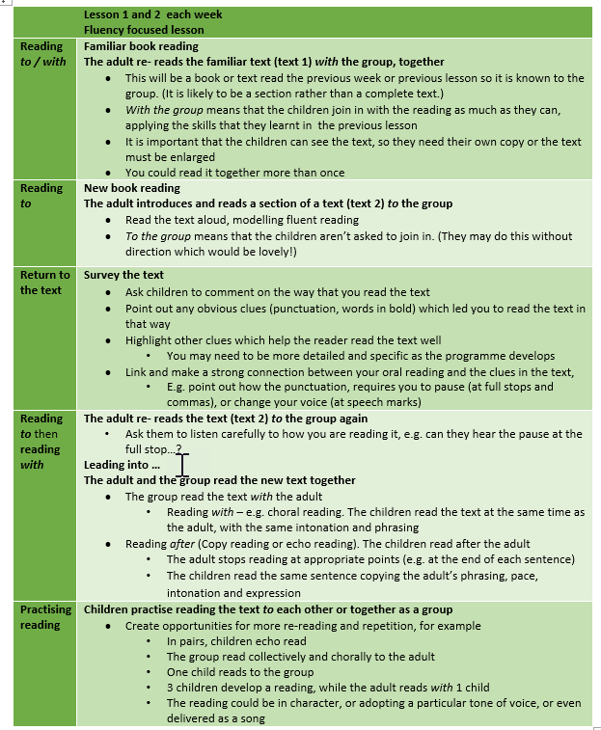

Slide 17
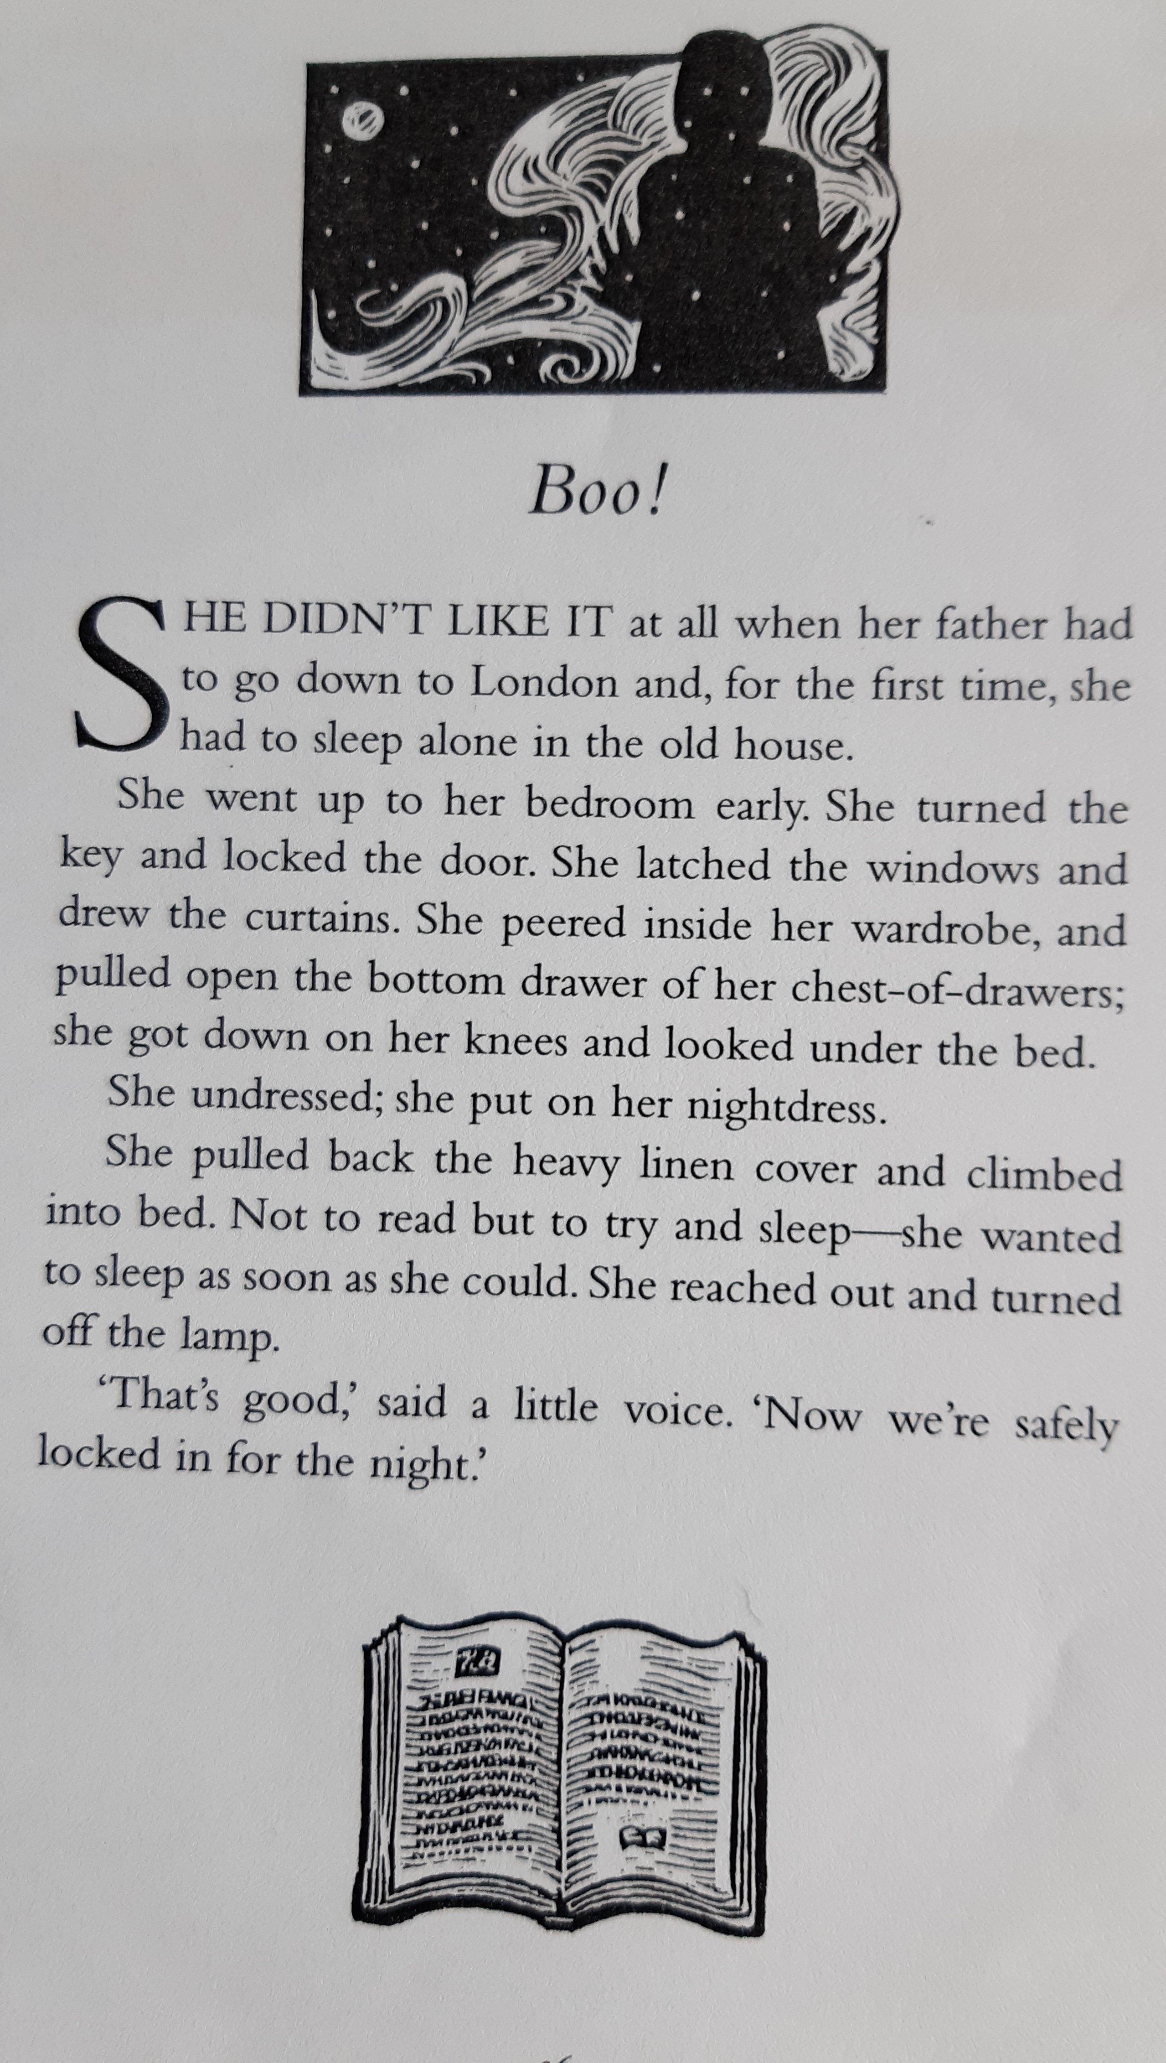
Boo!

Slide 18
Read the text to the group
Step 1
Survey the text – point out the clues
Step 2
Re-read the text to the group
Step 3
Re-read the text with the group – echo read, choral read etc.
Practising reading – children read together
Reading Fluency Lesson sequence
Step 4
Step 5

Slide 19
Step 1 – model the reading to the group
Boo!
She didn’t like it at all when her father had to go down to London and, for the first time, she had to sleep alone in the old house.

Slide 20
Step 2 – survey the text – point out the clues you’re using
Exclamation mark tells me to read it with excitement – like I’m jumping out and surprising someone
 | Boo! She didn’t like it at all when her father had to go down to London and, for the first time, she had to sleep alone in the old house.
Adverbial phrase between commas – chunk
the words together as a unit
Natural (slight) pause after all
Sentences run on past the end of the line, keep reading!
Comma after and means that you pause there. And given emphasis

Slide 21
Step 3 – re-read the text to the group
Boo!
She didn’t like it at all when her father had to go down to London and, for the first time, she had to sleep alone in the old house.

Slide 22
Step 4 – re-read the text with the group, e.g. echo and choral reading
Read after me – using the echo reading technique
Boo!
She didn’t like it at all when her father had to go down to London and, for the first time, she had to sleep alone in the old house.

Slide 23
Step 4 – re-read the text with the group, e.g. echo and choral reading
Read with me – using the choral reading technique
Boo!
She didn’t like it at all when her father had to go down to London and, for the first time, she had to sleep alone in the old house.

Slide 24
Step 5 – children practise reading together
Practise reading aloud in your pair
Echo read – take it in turns to lead the reading and the other echo your phrasing and intonation
Choral read – read the text together, in turn being the leading or dominant voice
Boo!
She didn’t like it at all when her father had to go down to London and, for the first time, she had to sleep alone in the old house.
Notes:
Choral reading is reading aloud in unison with a whole class or group of children. It helps build children’s fluency, self-confidence and motivation. Because children are reading aloud together, children who ordinarily may feel self-conscious or nervous about reading aloud have built in support.
When reading a more familiar text together, the adult may wish to drop the volume of their reading for part of the text. You don’t stop reading but just play a less central role. Remember each re-reading, however done, must sound good!

Slide 25
Providing practice – (Applying reading)
Confidence is built by providing lots of opportunities to practise successfully at the skill. Opportunities such as:
Reading aloud to themselves (everyone reading together at the same time) or to the adult
Reading in pairs and small groups
Pair echo and choral reading
Reading to an audience (when confident)
Reading to older or younger children not in their group (only when very confident)
Notes:
I often invite confident pairs [or children I have over heard during pair reading to model this to the class] The children can give each other feedback on their reading using the checklist as a prompt.

Slide 26
Paired reading
In a paired reading activity, partners read aloud to each other. Pairs can be of the same reading level or you could combine a better reader with a weaker, less fluent reader.
The partners take turns to read, reading sentence by sentence, paragraph by paragraph or section by section. The amount to be read might be agreed beforehand or you might ask children to develop a signal which indicates when they want their partner to take over the reading.
You might also want to discuss with the pairs what should happen if a reader makes a mistake or can’t read a particular word.
Notes:
Our expectation is that all children have a copy of the text and they follow their partner’s reading so that if a mistake is made they can support each other.

Slide 27
Have fun with it!
Reading in a specific manner
Paired reading can take many forms and you may settle quickly into an approach that the group enjoy and therefore want to repeat, alternatively you may want to try different models. You might ask the pairs to
Read in a particular tone of voice
Read as if one of the characters was speaking or telling the story
Read with a particular emotion in their voice, e.g. as if frightened, angry
Read as if they were a newsreader on television, or someone making an important announcement

Slide 28
Which texts will support developing Fluency?
Sections of familiar texts
Retellings of well – known stories
Texts that children have read before
(Familiarity builds confidence which can be extended through the repeated re-readings)

Slide 29
So… Which are good texts for reading aloud?
Really any texts which uses language in lively, interesting ways are likely to work well.
Texts where the language is patterned, where there are repetitions or refrains, where there are opportunities for emotions to emerge from the words or where the readers can have fun with the language.
Texts written to be recited, sung or spoken are likely to work particularly well.
Quality of language should support reading aloud
Texts should contain the features (‘the clues’) which underpin effective reading aloud, e.g. range of punctuation marks, run on lines, chunked text, dialogue

Slide 30
Continued…
(Short) poems
Well-written picture books
Texts with strong phrasing
Texts with dialogue
Texts with imaginative use of punctuation and text formatting
Texts with a limited amount of technical (tier 3) vocabulary
Short sections of texts where meanings are clear and/ or interesting
Song lyrics
Poetry
Nursery rhymes
Important speeches from history
Letters

Slide 31
Useful features – texts should include some of the following
A range of punctuation, but particularly full stops and commas
Clauses punctuated by commas
Dialogue with speech punctuation
Sentences of different length, but including some examples where the sentences run on, past the end of the line
Phrases and clauses, e.g. noun phrases, which can be read as a ‘chunk’, a meaningful unit, e.g. the little red hen
Other text features, e.g. bold print

Slide 32
Example: Structure of the Week
 | Monday | Tuesday | Wednesday | Thursday | Friday
Lesson Focus | Cracking Comprehension Teaching Text | Cracking Comprehension Practice Text | Pathways to Read/ Class Novel Clarifying & unpicking the text | Pathways to Read/ Class Novel Fluency on familiar text broken into short chunks | Pathways to Read/ Class Novel Reading for Pleasure
Reciprocal Reading Strategies Predicting, clarifying, summarizing, sequencing

